Slide 1
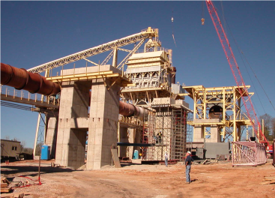
Lime Production- Arkansas Lime
Project: Arkansas Lime - Batesville Arkansas
New Lime Production Line
Scope: Construction of new line
Foundations and steel
Mechanical and piping
Electrical and Instrumentation
Equipment installation
Start-up
Project Equipment:
New Metso Kiln
New Metso Preheater
Stone Handling Tunnel
Primary Crusher
Storage silos
Other

Slide 2
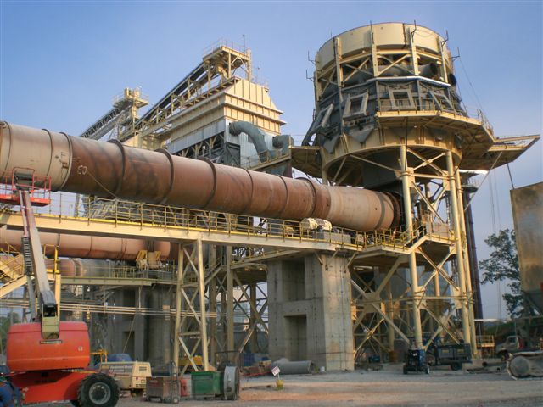
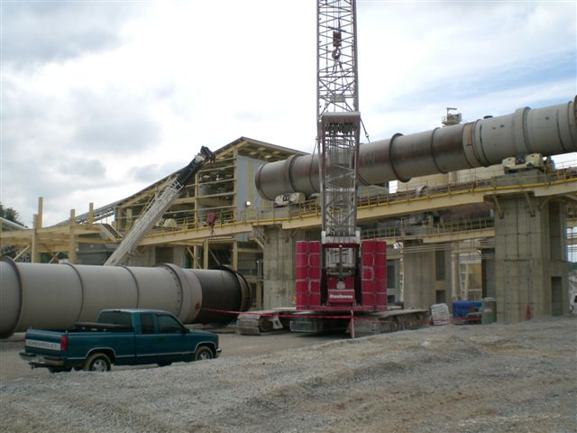
Lime Production – Arkansas Lime, Batesville, AR
Equipment Setting:
Preheater, Baghouse, Kiln and Burner Building
Preheater, Baghouse & Kiln
Kiln and Burner Building

Slide 3
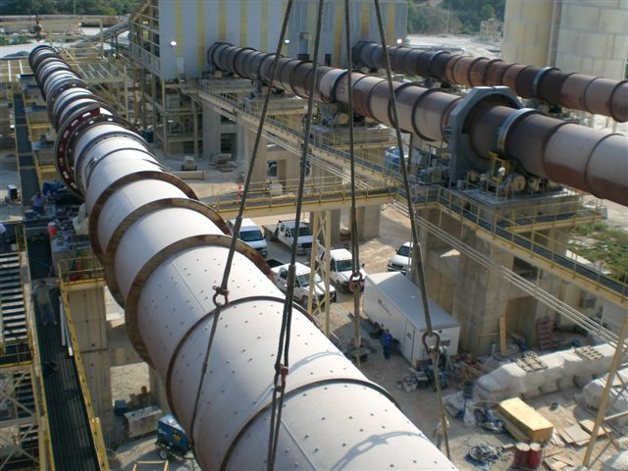
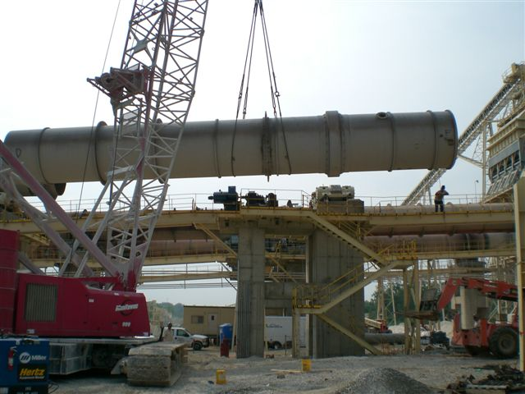
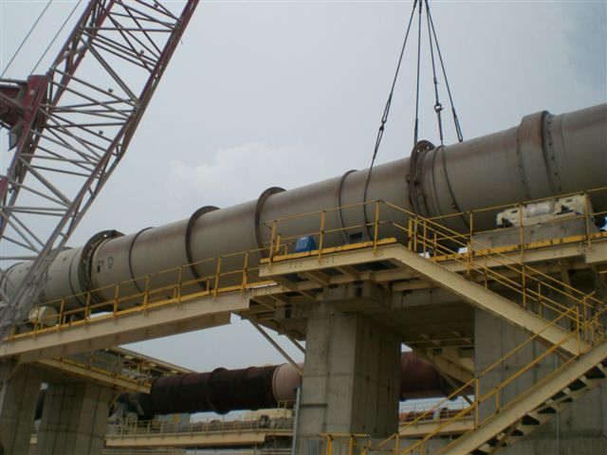
Lime Production- Batesville, AR
Equipment Setting:
Kiln

